Slide 1
Pointers in C

Slide 2
Learning Objectives
Understand memory addresses
Understand the concept of pointers
Learn the use of pointer variables and understand call-by-value and call-by-address
Get acquainted with dereferencing
Study equivalence among arrays and pointers—treating pointers as arrays
Learn about the concept and construction of array of pointers and pointer to array

Slide 3
Learning Objectives
Discuss pointers and functions—parameter passing techniques, pointers as function parameters.
Get an idea about pointers to functions—functions as arguments to another function.
Understand dynamic memory allocation using pointers.
Comprehend memory leak, memory corruption, and garbage collection.
Decipher (long) pointer declarations.
Understand pointer arithmetic.

Slide 4
Key Words
Dynamic data structures: Those that are built up from blocks of memory allocated from the heap at run-time.
Memory leak: A commonly used term indicating that a program is dynamically allocating memory but not properly deallocating it, which results in a gradual accumulation of unused memory by the program to the detriment of other programs, the operating system, and itself.
Heap :This memory region is reserved for dynamically allocating memory for variables at run-time. Dynamic memory allocation is done by using the malloc() or calloc() functions

Slide 5
Key Words
Call by address: facilitating the changes made to a variable in the called function to become permanently available in the function from where the function is called.
Call-by-value :A particular way of implementing a function call, in which the arguments are passed by their value (i.e., their copies).
Dangling pointer: A pointer pointing to a previously meaningful location that is no longer meaningful; usually a result of a pointer pointing to an object that is deallocated without resetting the value of the pointer.

Slide 6
Key Words
Dynamic memory allocation :The process of requesting and obtaining additional memory segments during the execution of a program.
Function pointer: A function has a physical location in memory that can be assigned to a pointer. Then it is called function pointer. This address is the entry point of the function and it is the address used when the function is called.
Garbage collection: If only implicit dynamic allocation is allowed then deallocation must also be done by implicit means, which is often called garbage collection.

Slide 7
Key Words
NULL :A special C constant, defined as macro in stdio.h as or 0, or (void*)), that can be used as the null value for pointers.
Null pointer: A null pointer is a special pointer value that points nowhere. I is initialized with value 0 or NULL.
Pointer : A value or a variable with two attributes: (i) an address and (ii) a data type of what should be found at that address.

Slide 8
Key Words
Ragged array: An array of pointers whose elements are used to point to arrays of varying sizes is called a ragged array.
Stack :A data structure resembling a deck of cards; a new item can only be put on top of the deck (the push operation) or removed from the top of the deck (the pop operation).
Static memory allocation: Memory layout for static data prepared by the compiler.
Void pointer :A void pointer is a special type of pointer that can point to any data type,

Slide 9
Understanding Memory Addresses
All computers have primary memory, also known as RAM or random access memory.
For example, a computer may have 16, 32, 64, 128, 256, or 512 MB of RAM installed.
RAM holds the programs that the computer is currently running along with the data they are currently manipulating.

Slide 10
Understanding Memory Addresses
C uses pointers in three main ways.
Pointers in C provide an alternative means of accessing information stored in arrays, which is especially valuable when working with strings. There is an intimate link between arrays and pointers in C.
C uses pointers to handle variable parameters passed to functions.
They are used to create dynamic data structures, those that are built up from blocks of memory allocated from the heap at run-time. This is only visible through the use of pointers.

Slide 11
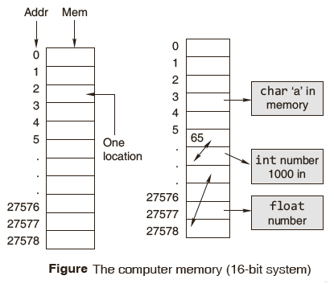
Understanding Memory Addresses
The stack has three major functions:
1. The stack provides the storage area for local variables declared within the function.
2. The stack stores housekeeping information involved when function call is made.
3. The stack is needed for recursive call.
© Oxford University Press 2013. All rights reserved.

Slide 12
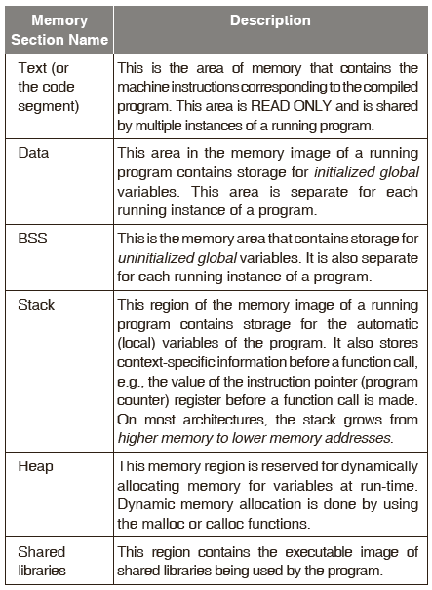
Memory Layout Summary

Slide 13
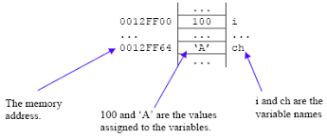
Address Operator (&)
Pointer address operator is denoted by ‘&’ symbol
2.When we use ampersand symbol as a prefix to a variable name ‘&’, it gives the address of that variable.
lets take an example –
&n - It gives an address on variable n

Slide 14
Address Operator (&) contd
#include<stdio.h>
void main()
{
int n = 10;
printf("\nValue of n is : %d",n);
printf("\nValue of &n is : %u",&n);
}
In order to print the variable we simply use name of variable while to print the address of the variable we use ampersand along with %u
Consider the above example, where we have used to print the address of the variable using ampersand operator
Output :
Value of n is : 10
Value of &n is : 1002

Slide 15
Pointer
A pointer is a group of cells that can hold an address.
A pointer provides a way of accessing a variable without referring to the variable directly.
A pointer variable is a variable that holds the memory address of another variable.
Put another way, the pointer does not hold a value in the traditional sense; instead, it holds the address of another variable.

Slide 16
Pointer
They are called pointers for the simple reason that, by storing an address, they ‘point’ to a particular point in memory.
A pointer points to that variable by holding a copy of its address.
Because a pointer holds an address rather than a value, it has two parts. The pointer itself holds the address. The address points to a value.

Slide 17
Pointers can be used to:
Call by address, thereby facilitating the changes made to a variable in the called function to become permanently available in the function from where the function is called.
Return more than one value from a function indirectly.
Pass arrays and strings more conveniently from one function to another.
Manipulate arrays more easily by moving pointers to them (or to parts of them) instead of moving the arrays themselves.

Slide 18
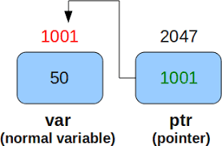
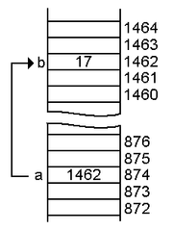
understand pointer

Slide 19
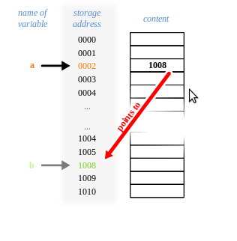
understand pointer

Slide 20
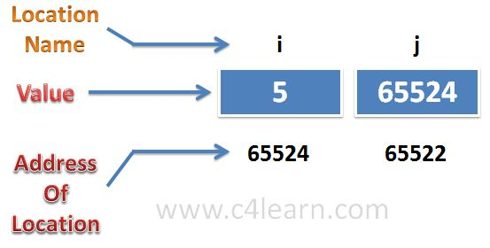
understand pointer
Which one is pointer here ? i or j ?

Slide 21
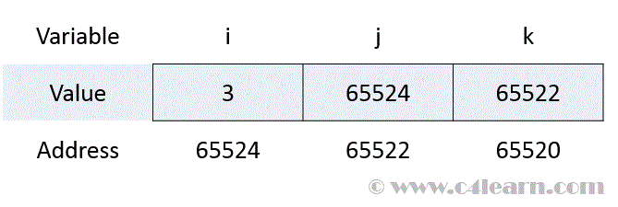
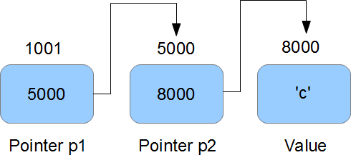
pointer to pointer

Slide 22
Pointers can be used to:
Create complex data structures, such as linked lists and binary trees, where one data structure must contain references to other data structures.
Communicate information about memory, as in the function malloc() which returns the location of free memory by using a pointer.
Compile faster, more efficient code than other derived data types such as arrays.

Slide 23
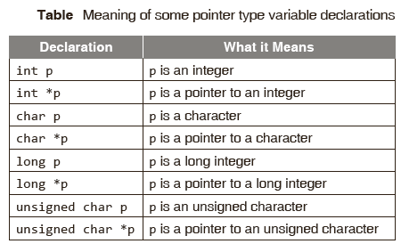
Declaring a Pointer
Just as any other variable in a program, a pointer has to be declared; it will have a value, a scope, a lifetime, a name; and it will occupy a certain number of memory locations. The pointer operator available in C is ‘*’, called ‘value at address’ operator.
The syntax for declaring a pointer variable is
datatype * pointer_variable;

Slide 24
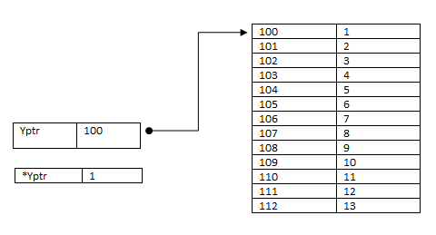
Pointer pointing to?
int *ip; /* pointer to an integer */
double *dp; /* pointer to a double */
float *fp; /* pointer to a float */
char *ch /* pointer to a character */

Slide 25
Consider the following program
OUTPUT
In Turbo C:
the size of integer pointer is 2
the size of fl oat pointer is 2
the size of double pointer is 2
the size of character pointer is 2
In GCC:
the size of integer pointer is 4
the size of fl oat pointer is 4
the size of double pointer is 4
the size of character pointer is 4
#include <stdio.h>
int main()
{
int *p;
float *q;
double *r;
printf(“\n the size of integer pointer is %d”,
sizeof(p));
printf(“\n the size of fl oat pointer is %d”,
sizeof(q));
printf(“\n the size of double pointer is %d”,
sizeof(r));
printf(“\n the size of character pointer is %d”,
sizeof(char *));
return 0;
}

Slide 26
Drawbacks
A programmer is likely to commit mistakes such as typographical mistakes and providing wrong offsets.
Porting the code to other implementations would require changes, if data type sizes differ. This would lead to portability issues.
Pointers have data types but the size of a pointer variable is always four bytes (in a 32-bit machine) whatever the data type is used in declaring it.

Slide 27
Where is a Pointer Stored?
It can be defined and stored globally, or it can be defined local to a function and stored on the stack but generally not stored on the heap.
A pointer is like any other variable in the sense that it requires storage space somewhere in the computer’s memory, but it is not like most variables because it contains no data, only an address.
Since it is an address, it actually contains a number referring to some memory location.

Slide 28
Initializing Pointers
Unlike a simple variable that stores a value, a pointer must be initialized with a specified address prior to its use.
A pointer should be initialized with another variable’s memory address, with 0, or with the keyword NULL prior to its use;
Otherwise the result may be a compiler error or a run-time error.
int a = 10 ;
int *ptr ; //pointer declaration
ptr = &a ; //pointer initialization

Slide 29
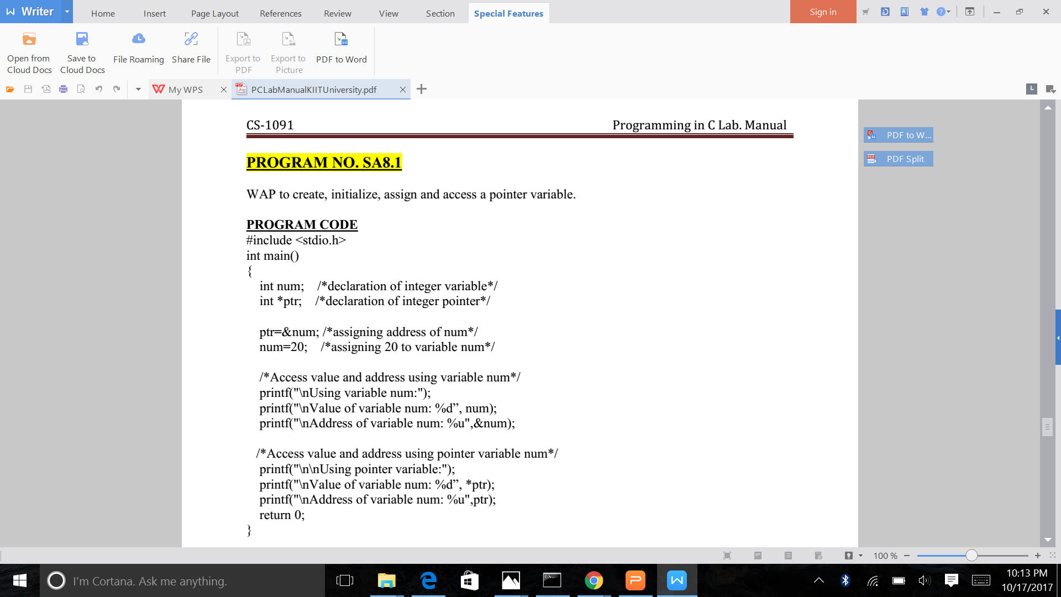
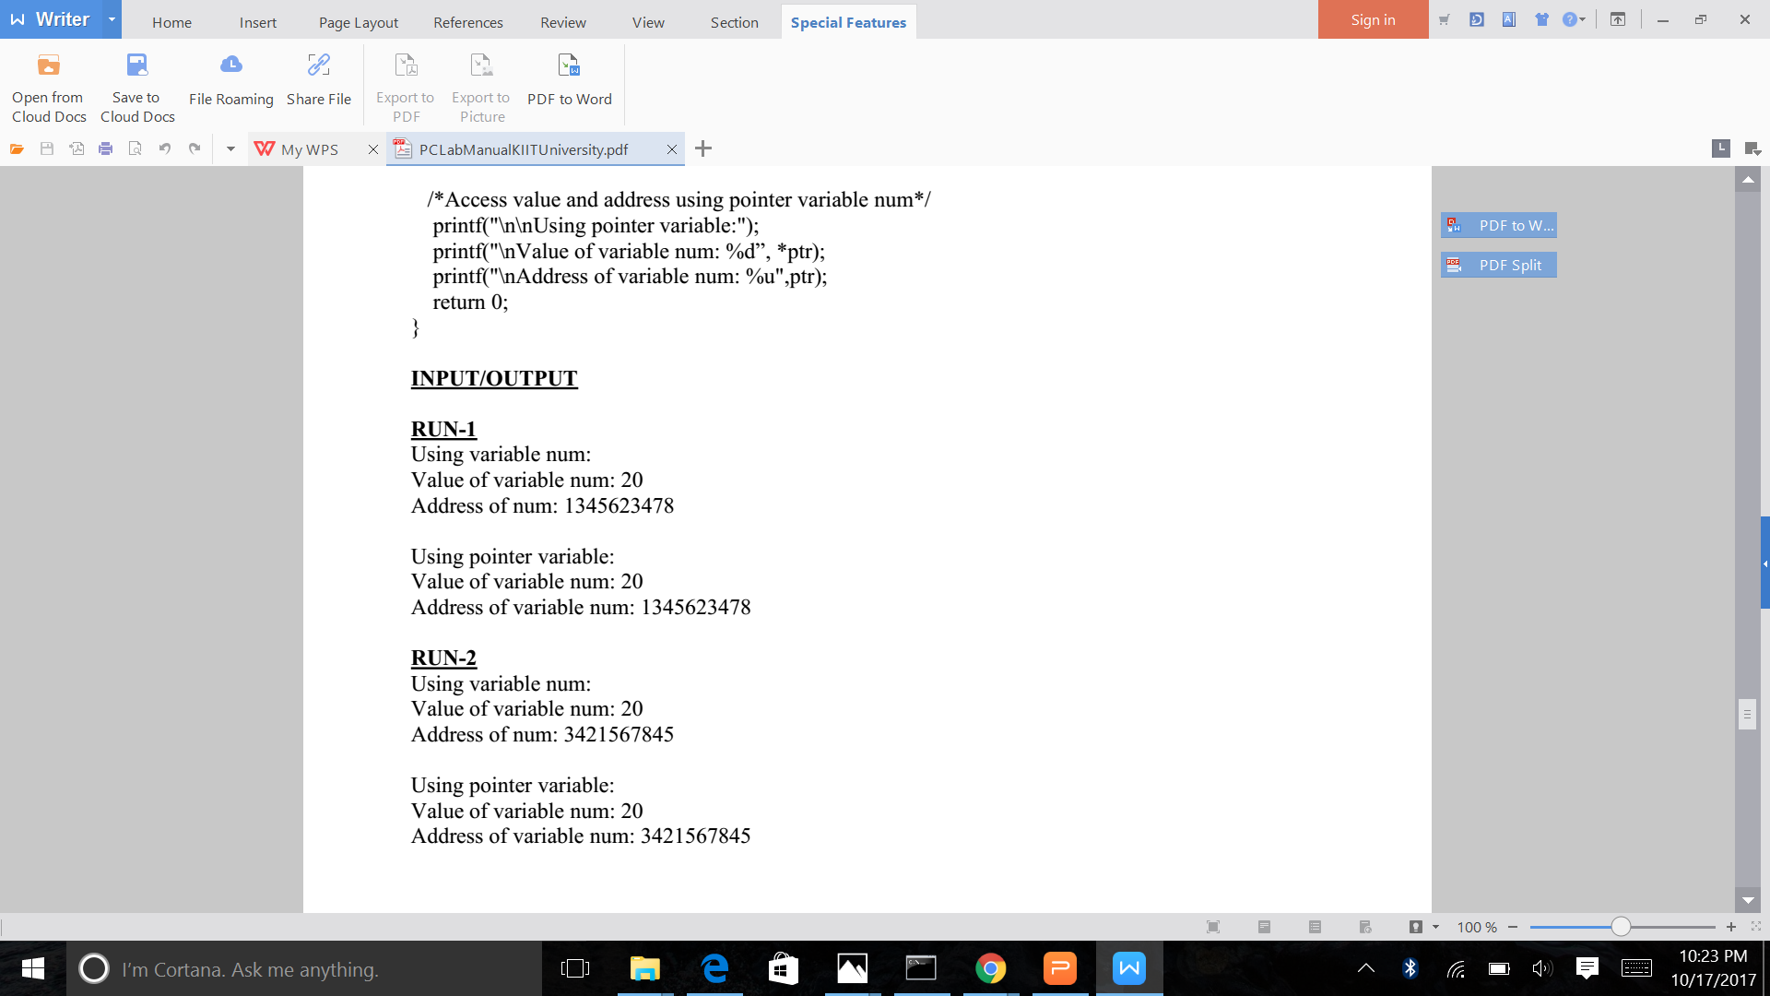
Create , initialize, assign and access pointer variable

Slide 30
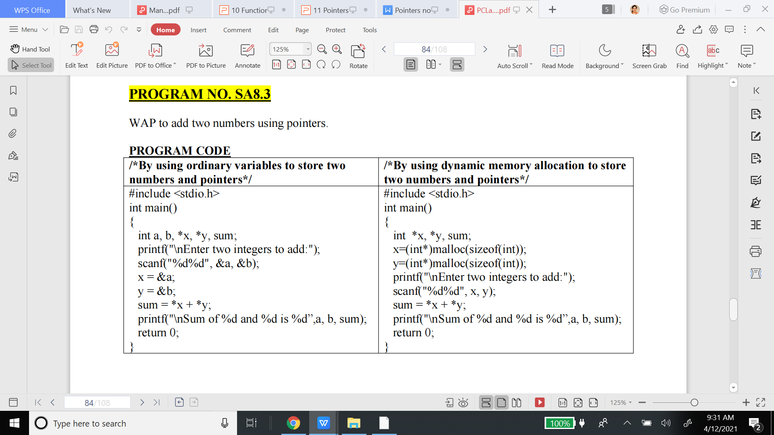

Slide 31
Look very carefully now!
int x =1, y =2, z[10];
z[10] = {1, 2, 3, 5, 6, 7, 8,9, 10, 34};
int *ip //ip is a pointer to int
ip=&x //ip now points to x
//print *ip
y = *ip // y is now 1
//print y
*ip = 0; //x is now 0 (note, ip is not 0)
//print x
ip = &z[0] //ip now points to z[0]
//print z[0] printf (“\n%d”, p[i])

Slide 32
#include <stdio.h>
int main()
{
int x =1, y =2, z[10] = {1, 2, 3, 5, 6, 7, 8,9, 10, 34};
int *ip ; //ip is a pointer to int
ip=&x; //ip now points to x
printf("\n priting *ip %d",*ip) ; //print *ip
y = *ip ; // y is now 1
printf("\n priting y %d", y) ; //print y
*ip = 0; //x is now 0 (note, ip is not 0)
printf("\n priting x %d", x) ; //print x
ip = &z[0] ; //ip now points to z[0]
printf("\n priting z[0] address %u", ip);
printf("\n priting z[1] address %u", ip+1);
printf("\n priting z[4] %d", *ip+5); //print z[0]
;
return 0;
}

Slide 33
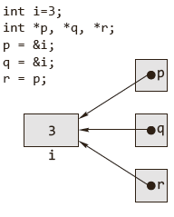
Assigning the Pointer
A pointer is bound to a specific data type (except pointer to void) . A pointer to an int cannot hold the address of a character variable in which case a compiler error would result.
The following pointer initializations are invalid.
int a=3, *ip;
fl oat *p;
char ch=’A’;
p=&a;
ip=&ch:
r points to the same address that p points to, which is the address of i.
We can assign pointers to one another, and the address is copied from the right-hand side to the left-hand side during the assignment.
© Oxford University Press 2013. All rights reserved.

Slide 34
Printing Pointer Value
A pointer variable contains a memory address that points to another variable. To print the memory address stored in pointers and non-pointer variables using the %p conversion specifier and to learn the use of the %p conversion specifier.
Addresses must always be printed using %u or %p or %x. If %p is used, the address is printed in hexadecimal form. If %u is used, address is printed in decimal form.
#include <stdio.h>
int main(void)
{
int a=10, *p;
p=&a;
printf(“\n *p = %d”, *p);
return 0;
}
Output:
p = 0022FF2C

Slide 35
Is it possible to assign a constant to a pointer variable?
A pointer is a variable that holds the address of a memory location. That is, pointers are variables that point to memory locations.
In C, pointers are not allowed to store any arbitrary memory address, but they can only store addresses of variables of a given type.
Consider the following code:
int *pi;
pi= (int*)1000;
*pi = 5;
Location 1000 might contain the program. Since it is a read only, the OS will throw up a segmentation fault.

Slide 36
Indirection Operator & Dereferencing
The primary use of a pointer is to access and, if appropriate, change the value of the variable that the pointer is pointing to. The other pointer operator available in C is ‘*’, called the ‘value at address’ operator. It returns the value stored at a particular address.
The value at address operator is also called indirection operator or dereference operator.
In the following program, the value of the integer variable num is changed twice.

Slide 37
Example
#include <stdio.h>
int main()
{
int num = 5;
int *iPtr = &num;
printf(“\n The value of num is %d”, num);
num = 10;
printf(“\n The value of num after num = 10 is\
%d”, num);
*iPtr = 15;
printf(“\n The value of num after *iPtr = 15 is\
%d”, num);
return 0;
}
Output:
The value of num is 5
The value of num after num = 10 is 10
The value of num after *iPtr = 15 is 15

Slide 38
Void Pointer
A void pointer is a special type of pointer.
It can point to any data type, from an integer value or a float to a string of characters.
Its sole limitation is that the pointed data cannot be referenced directly (the asterisk * operator cannot be used on them) since its length is always undetermined.
Therefore, type casting or assignment must be used to turn the void pointer to a pointer of a concrete data type to which we can refer.
The type casting or assignment must be used to turn the void pointer to a pointer of a concrete data type to which we can refer.

Slide 39
Example
#include <stdio.h>
int main()
{
int a=5,
double b=3.1415;
void *vp;
vp=&a;
printf(“\n a= %d”, *((int*)vp));
vp=&b;
printf(“\n a= %d”, *((double *)vp));
return 0;
}
Output:
a= 5
b= 3.141500

Slide 40
Null Pointer
A null pointer is a special pointer that points nowhere. That is, no other valid pointer to any other variable or array cell or anything else will ever be equal to a null pointer.
#include <stdio.h>
int *ip = NULL;
It is also possible to refer to the null pointer using a constant 0, and to set null pointers by simply saying int *ip = 0;
NULL is a constant that is defined in the standard library and is the equivalent of zero for a pointer. NULL is a value that is guaranteed not to point to any location in memory.

Slide 41
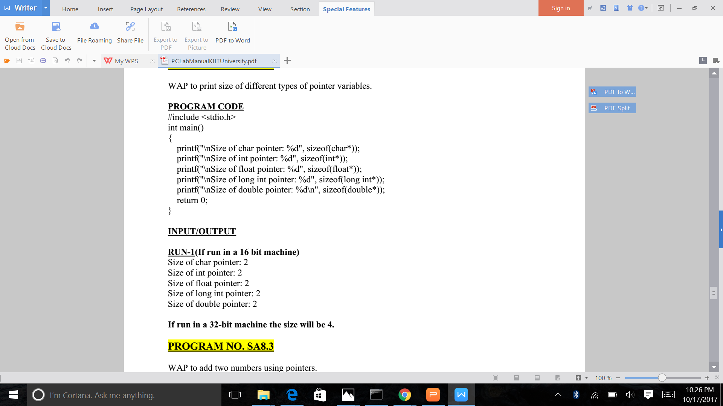
print different size of pointer variables

Slide 42
Use of Pointers
Call by address:
One of the typical applications of pointers is to support call by reference.
Typically a function call is made to communicate some arguments to the function.
C makes use of only one mechanism to communicate arguments to a function: call by value.
This means that when a function is called, a copy of the values of the arguments is created and given to the function.

Slide 43
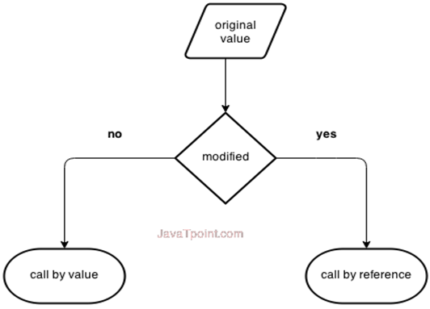
Call by value / call by reference
Pointer helps in call by reference

Slide 44
Example
void swap(int,int);
int main()
{
int x=5,y=10;
printf(“%d %d\n”,x,y);
swap(x,y);
printf(“%d %d\n”,x,y);
return 0;
}
Output:
5 10
5 10 No swapping
#include <stdio.h>
void swap(int a, int b)
{
int temp;
temp=a;
a=b;
b=temp;
}

Slide 45
Call by Address
To make a function be able to modify a certain variable, the function must be provided with information about the location of the variable in memory (i.e., its address).
If the function knows where the variable is in memory, it will be able to access that area of memory by using pointers and change its content. This is known as call by address.
C only supports call by value. C does not support call by reference in true sense, but it can be simulated through the use of pointers known as call by address.

Slide 46
call by address - swap
#include <stdio.h>
void swap(int *a, int *b)
{
int temp;
temp = *a;
*a = *b;
*b = temp;
}
void swap(int *,int *);
int main()
{
int x=5,y=10;
printf(“%d %d\n”,x,y);
swap(&x, &y);
printf(“%d %d\n”,x,y);
return 0;
}
Output:
5 10
10 5

Slide 47
Returning more than one value from a function
Functions usually return only one value and when arguments are passed by value, the called function cannot alter the values passed and have those changes reflected in the calling function.
Pointers allow the programmer to ‘return’ more than one value by allowing the arguments to be passed by address, which allows the function to alter the values pointed to, and thus ‘return’ more than one value from a function.

Slide 48
call by reference
#include <stdio.h>
float compute(float, float *);
int main()
{
float r, area, perimeter;
printf(“\n enter the radius
of the circle:”);
scanf(“%f”,&r);
area=compute(r, &perimeter);
printf(“\n AREA = %f”, area);
printf(“\n PERIMETER = %f”, perimeter);
return 0;
}
float compute(float r, float *p)
{
float a;
a=(float)3.1415 * r * r;
*p=(float)3.1415 * 2 * r;
return a;
}

Slide 49
Returning Pointer from a function
It is also possible to return a pointer from a function. When a pointer is returned from a function, it must point to data in the calling function or in the global variable.
Consider the following program. In this program, a pointer would point an integer variable whichever is larger between two variables through a function which returns the address of the larger variable.

Slide 50
example
#include <stdio.h>
int *pointMax(int *, int *);
int main(void)
{
int a,b,*p;
printf(“\n a = ?”);
scanf(“%d”,&a);
printf(“\n b = ?”);
scanf(“%d”,&b);
p=pointMax(&a,&b);
printf(“\n*p = %d”, *p);
return 0;
}
int *pointMax(int *x, int *y)
{
if(*x>*y)
return x;
else
return y;
}
Output:
a = ?5
b = ?7
*p = 7
//print the value of x and y inside function

Slide 51
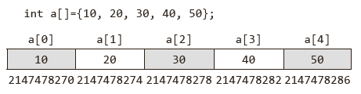
Arrays & Pointers
One-dimensional Arrays and Pointers
An array is a non-empty set of sequentially indexed elements having the same type of data.
Each element of an array has a unique identifying index number. Changes made to one element of an array does not affect the other elements.
An array occupies a contiguous block of memory. The array a is laid out in memory as a contiguous block, as shown.

Slide 52
One Dimensional Arrays & Pointers
An array name is a constant pointer to the first element of the array.
Therefore, in the declaration −
double balance[50];
balance is a pointer to &balance[0], which is the address of the first element of the array balance.
Thus, the following program fragment assigns p as the address of the first element of balance
double *p;
double balance[10];
p = balance;

Slide 53
One Dimensional Arrays & Pointers
It cannot be used as l- value.That is array names cannot be used as variables on the left of an assignment operator.
Both array and &array would give the base address of the array.
Example
#include <stdio.h>
int main()
{
int array[]={10, 20, 30, 40, 50};
printf(“%u %u”, array, &array[0]);
return 0;
}
Output:
2147478270 2147478270

Slide 54
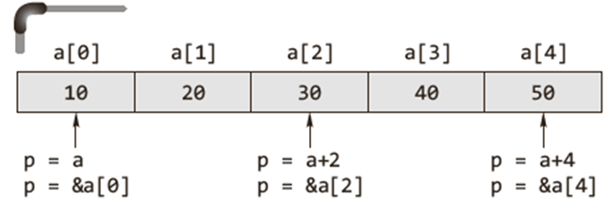

One-dimensional Arrays & Pointers
Below figure depicts the equivalence among array notation and pointer notation.
For any one-dimensional array a and integer i, the following relationships are always true.
• a[i] ≡ *(a+i) ≡ *(i+a) ≡ i[a]

Slide 55
One-dimensional Arrays & Pointers
A pointer variable (of the appropriate type) can also be
used to initialize or point to the first element of the array.
#include<stdio.h>
int main()
{
int a[] ={10, 20, 30, 40, 50};
int i, *p;
p=a ;// same as p=&a[0]
for (i=0, i<5; ++i)
{
printf (“\n%d”, p[i]);
}
return 0;
}
printf (“\n%d”,*(p+i));
printf (“\n%d”, *(i+p));
printf (“\n%d”, i[p]);

Slide 57
One-dimensional Arrays & Pointers
A pointer variable (of the appropriate type) can also be
used to initialize or point to the first element of the array.
#include<stdio.h>
int main()
{
int a[] ={10, 20, 30, 40, 50};
int i, *p;
p=a ;// same as p=&a[0]
for (i=0, i<5; ++i)
{
printf (“\n%d”, *(p+i));
}
return 0;
}
printf (“\n%d”,*(p+i));
printf (“\n%d”, *(i+p));
printf (“\n%d”, i[p]);

Slide 58
Array - take input and print
#include <stdio.h>
int main() {
int data[5];
printf("Enter elements: ");
for (int i = 0; i < 5; ++i)
scanf("%d", data + i);//
printf("You entered: \n");
for (int i = 0; i < 5; ++i)
printf("%d\n", *(data + i));
return 0;
}

Slide 59
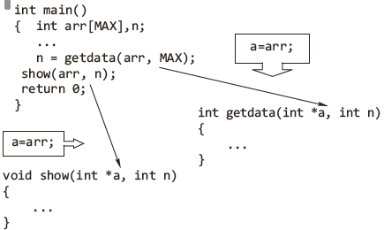
Passing an Array to a Function
An array may be passed to a function, and the elements of that array may be modified without having to worry about referencing and dereferencing.

Slide 60
Passing an Array to a Function
When an array is passed to a function, it degenerates to a pointer.
All array names that are function parameters are always converted into pointers by the compiler.
Because when passing an array to a function, the address of the zero-th element of the array is copied to the pointer variable which is the formal parameter of the function.
However, arrays and pointers are processed differently by the compiler, represented differently at runtime.

Slide 61
#include <stdio.h>
/* function declaration */
double getAverage(int *arr, int size);
int main () {
/* an int array with 5 elements */
int balance[5] = {1000, 2, 3, 17, 50};
double avg;
/* pass pointer to the array as
an argument */
avg = getAverage( balance, 5 ) ;
/* output the returned value */
printf("Average value is: %f\n", avg );
return 0;
}
Get average of numbers
double getAverage(int *arr, int size) {
int i, sum = 0;
double avg;
for (i = 0; i < size; ++i) {
sum += arr[i];
}
avg = (double)sum / size;
return avg;
}
OUTPUT : Average value is: 214.40000

Slide 62
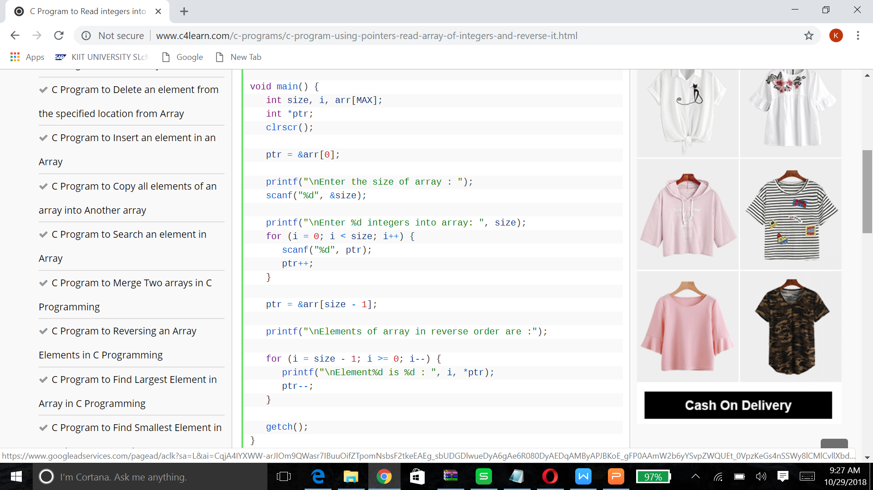
Print integer array in reverse order

Slide 63
Differences between Array Name & Pointer
When memory is allocated for the array, the starting address is fixed, i.e., it cannot be changed during program execution. Therefore, array name is an address constant.
The & (address of) operator normally returns the address of the operand. However, arrays are the exception.
When applied to an array (which is an address), it has the same value as the array reference without the operator.
This is not true of the equivalent pointers, which have an independent address.
The sizeof operator returns the size of the allocated space for arrays.
In case of a pointer, the sizeof operator returns two or four or more bytes of storage (machine dependent).

Slide 64
Pointers & Strings
Strings are one-dimensional arrays of type char. By convention, a string in C is terminated by the end-of-string sentinel \0, or null character.
A string constant is treated by the compiler as a pointer.
For a string, the number of elements it has need not be passed to a function because it has the terminating null character.

Slide 65
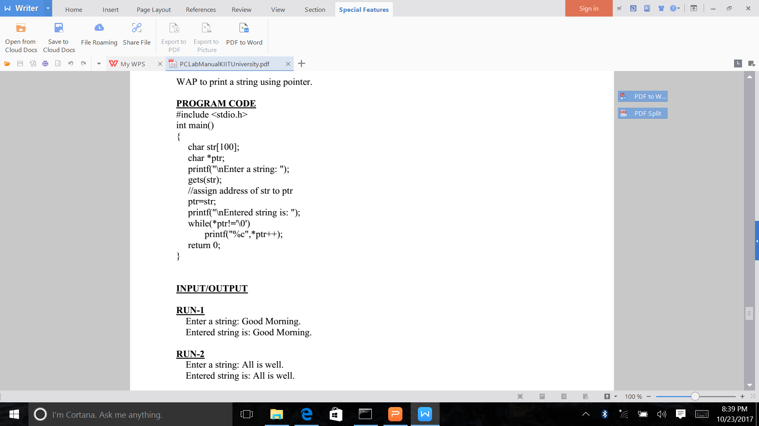
Print a string using a pointer

Slide 66
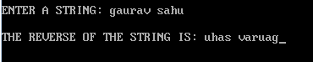
reverse a string using pointer
#include <stdio.h>
#include <string.h>
void main()
{
char str[100];
char *s;
//s=&str[100];
s=str;
int len,i;
printf("\nENTER A STRING: ");
gets(s);
len=strlen(s);
printf("\nTHE REVERSE OF THE STRING IS:");
for(i=len;i>=0;i--)
{
printf("%c",*(s+i));
}
}

Slide 67
Pointer Arithmetic
The only valid operations on pointers are as follows.
Assignment of pointers to the same type of pointers: the assignment of pointers is done symbolically. Hence no integer constant except 0 can be assigned to a pointer.
Adding or subtracting a pointer and an integer.
Subtracting or comparing two pointers (within array limits) that point to the elements of an array

Slide 68
Pointer Arithmetic
Incrementing or decrementing the pointers (within array limits) that point to the elements of an array.
When a pointer to an integer is incremented by one, the address is incremented by two (as two bytes are used for int).
Such scaling factors necessary for the pointer arithmetic are taken care of automatically by the compiler.
Assigning the value 0 to the pointer variable and comparing 0 with the pointer. The pointer with address 0 points to nowhere at all.

Slide 69
Pointer Arithmetic
These valid address arithmetic are discussed below in detail. Do not attempt the following arithmetic operations on pointers. They will not work.
Addition of two pointers
Multiplying a pointer with a number
Dividing a pointer with a number

Slide 70
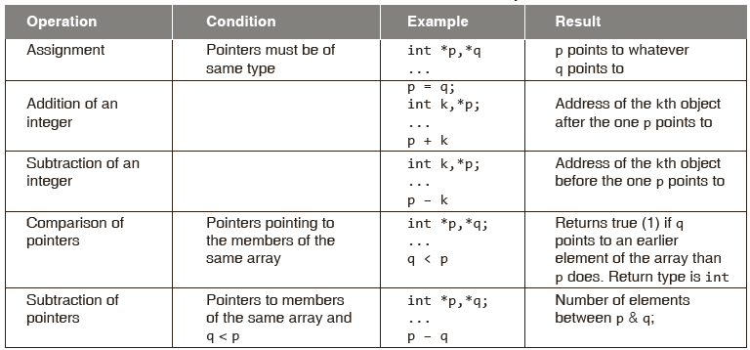
Pointer Arithmetic

Slide 71
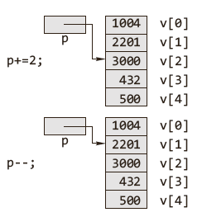
Pointers to an Array
We can use instructions such as += and -= to refer to different elements in the array.

Slide 72
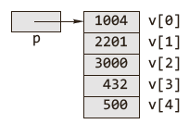
Pointers to an Array
We can declare a pointer to a simple integer value and make it point to the array as is done normally.
int v[5] = {1004, 2201, 3000, 432, 500};
int *p = v;
printf(“%d \n”, *p);
This piece of code displays the number, which the pointer p points to, that is the first number in the array, namely 1004.

Slide 73
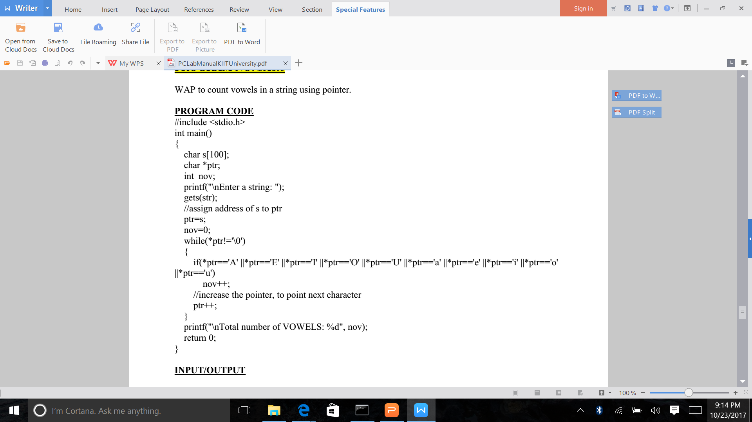
Count vowels in string using a pointer

Slide 74
#include<stdio.h>
#include<conio.h>
void main()
{
int numArray[10];
int i, sum = 0;
int *ptr;
printf("\nEnter 10 elements : ");
for (i = 0; i < 10; i++)
scanf("%d", &numArray[i]);
ptr = numArray; /* a=&a[0] */
for (i = 0; i < 10; i++)
{
sum = sum + *ptr;
ptr++;
}
printf("The sum of array elements : %d", sum);
}
Sum of all elements in an array using a pointer

Slide 75
#include <stdio.h>
#include <conio.h>
void main()
{
int *arr,i,j,tmp,n;
clrscr();
printf("Enter how many data you want to sort : ");
scanf("%d",&n);
for(i=0;i<n;i++)
scanf("%d",arr+i);
for(i=0;i<n;i++)
{
for(j=i+1;j<n;j++)
{
if( *(arr+i) > *(arr+j))
{
tmp = *(arr+i);
*(arr+i) = *(arr+j);
*(arr+j) = tmp;
}
}
}
Sort an array using a pointer
printf("\n\nAfter Sort\n");
for(i=0;i<n;i++)
printf("%d\n",*(arr+i));
getch();
}

Slide 76
Pointers to Functions
Declaration of a Pointer to a Function
Function pointers are declared as follows:
Return_type(*function_pointer_name (argument_type1, argument_type2, ...);
In the following example, function pointer name fp is declared. It points to function that take one float and two char and return an int.
int(*fp)(float, char, char)
Please note
int(*fp)() fp is declared as pointer to function which returns integer types.
int *fp() fp is a function that returns integer pointer

Slide 77
Pointers to Functions
Initialization of Function Pointers:
If function add() and sub() are declared as follows
int add(int, int); and int sub(int, int);
The names of these functions, add and sum, are pointers to those functions.
These can be assigned to pointer variables.
fpointer = add;
fpointer = sub;
Calling a Function using a Function Pointer
result1 = fpointer(4, 5);
result2 = fpointer(6, 2);result2 = fpointer(6, 2);

Slide 78
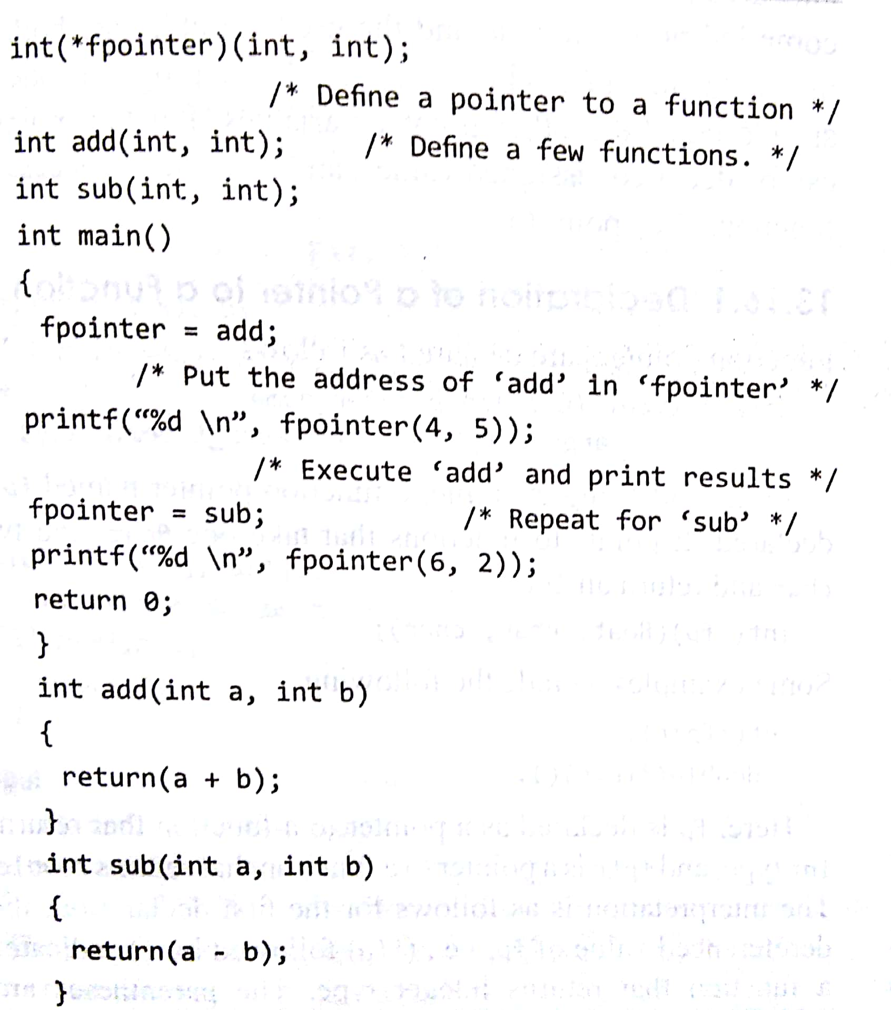
Pointers to Functions
Calling a function using a function pointer
Program to add and subtract numbers

Slide 79
Dynamic Memory Allocation
Static memory allocation
The compiler allocates the required memory space for a declared variable. By using the address of operator, the reserved address is obtained that may
be assigned to a pointer variable. Since most declared variables have static memory, this way of assigning pointer value to a pointer variable is known as static memory allocation.
Dynamic memory allocation
A dynamic memory allocation uses functions such as malloc() or calloc() to get memory dynamically. If these functions are used to get memory dynamically and the values returned by these functions are assigned to pointer variables, such assignments are known as dynamic memory allocation. Memory is assigned during run-time.

Slide 80
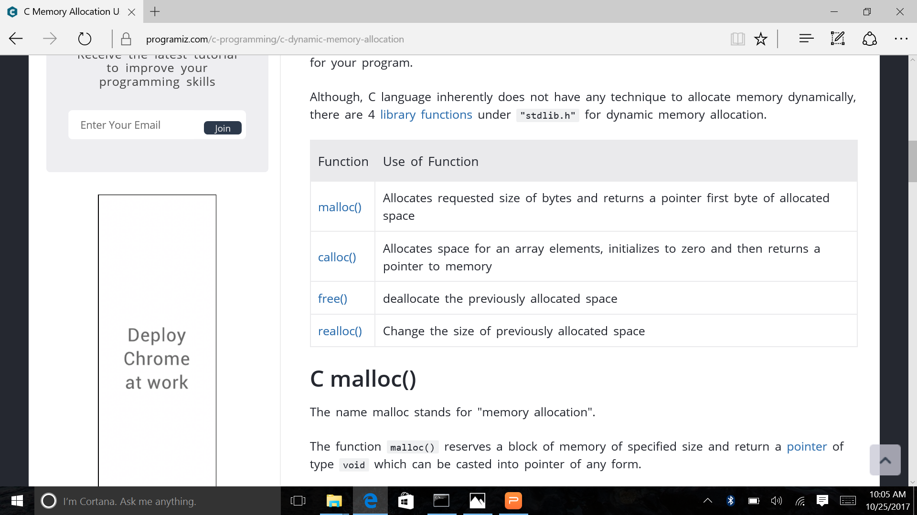
Library functions under "stdlib.h" for dynamic memory allocation.
Dynamic memory allocation allows your program to obtain more memory space while running, or to release it if it's not required.
In simple terms, Dynamic memory allocation allows you to manually handle memory space for your program.

Slide 81
Dynamic Memory Allocation
In dynamic memory allocation, memory is allocated at runtime from heap.
According to ANSI compiler, the block pointer returned by allocating function is a void pointer.
If sufficient memory is not available, the malloc()and calloc() returns a NULL.
According to ANSI compiler, a cast on the void pointer returned by malloc() is not required.

Slide 82
malloc()
The name malloc stands for "memory allocation".
Syntax of malloc()
ptr = (cast-type*) malloc(byte-size)
Example
ptr = (int*) malloc(100 * sizeof(int));
This statement will allocate either 200 or 400 according to size of int 2 or 4 bytes respectively and the pointer points to the address of first byte of memory.
Parameters
size − This is the size of the memory block, in bytes.
Return Value
This function returns a pointer to the allocated memory, or NULL if the request fails.

Slide 83
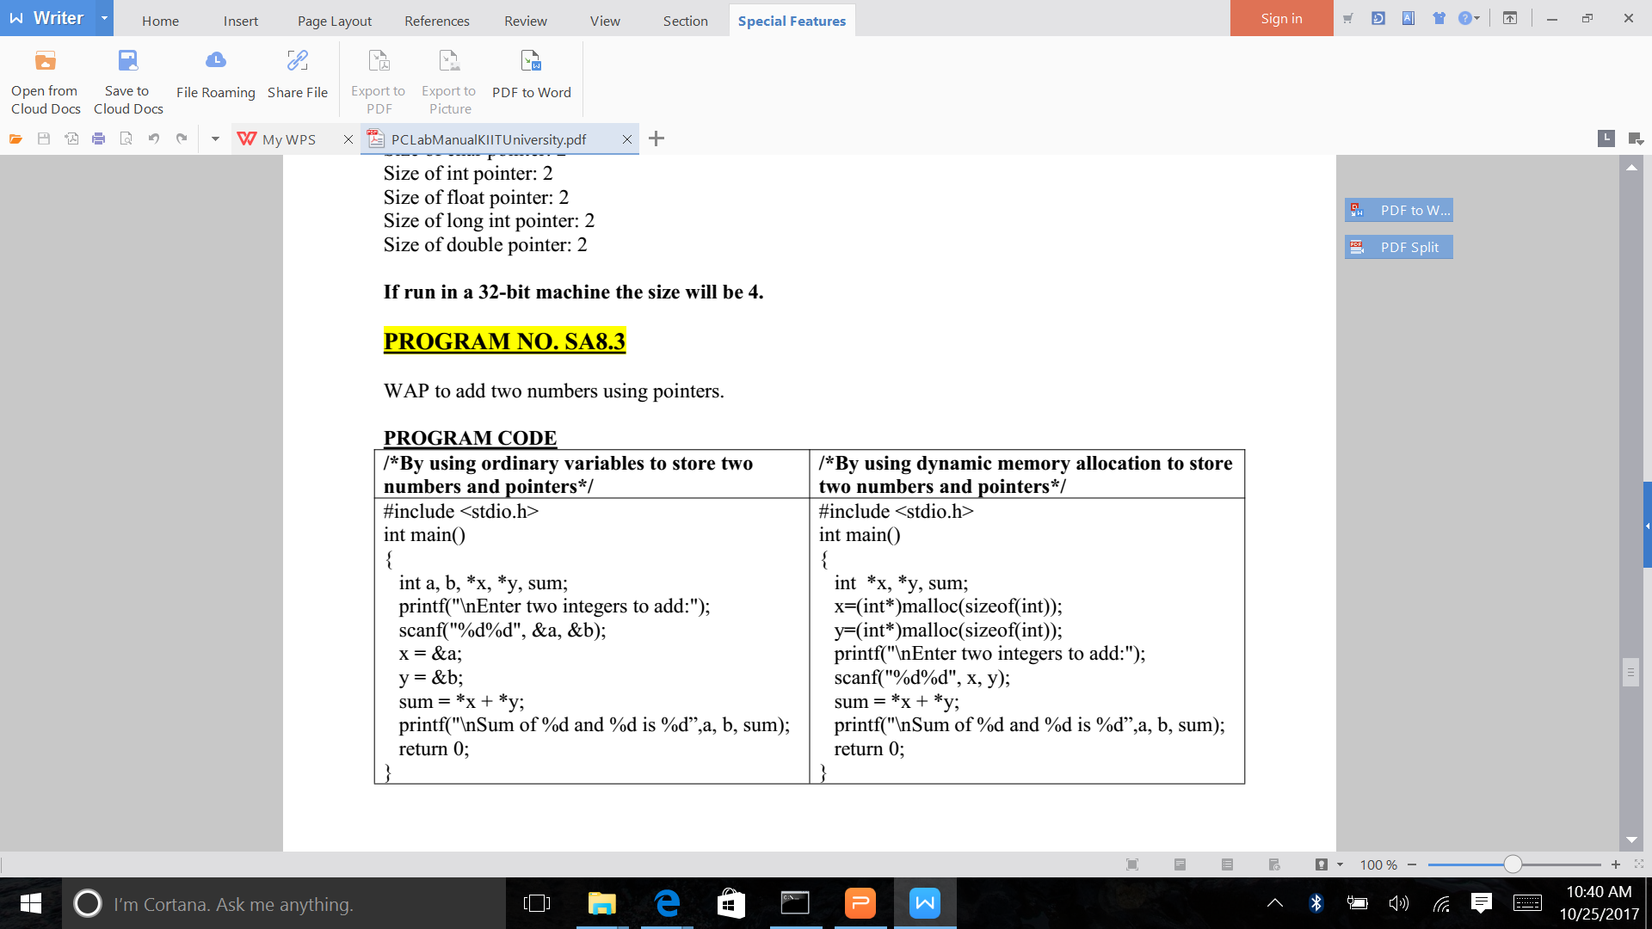
Add two numbers using pointer and using malloc

Slide 84
Dynamic Memory Allocation
Dynamic Allocation of Arrays:
To allocate a one-dimensional array of length N of some particular type where N is given by the user, simply use malloc() to allocate enough memory to hold N elements of the particular type.
First check if the memory allocation is successful.

Slide 85
Create an array, allocate memory and print sum of elemets
#include <stdio.h>
#include <stdlib.h>
int main()
{
int N,*a,i,s=0;
printf(“\n enter no. of elements of the array:”);
scanf(“%d”,&N);
a=(int *)malloc(N*sizeof(int));
if(a==NULL)
{
printf(“\n memory allocation unsuccessful...”);
exit(0);
}
printf(“\n enter the array elements one by one”);
for(i=0; i<N;++i)
{
scanf(“%d”,&a[i]));
/* equivalent statement
scanf(“%d”,(a+i));*/
s+=a[i];
}
printf(“\n sum is %d ”,s);
return 0;
}

Slide 86
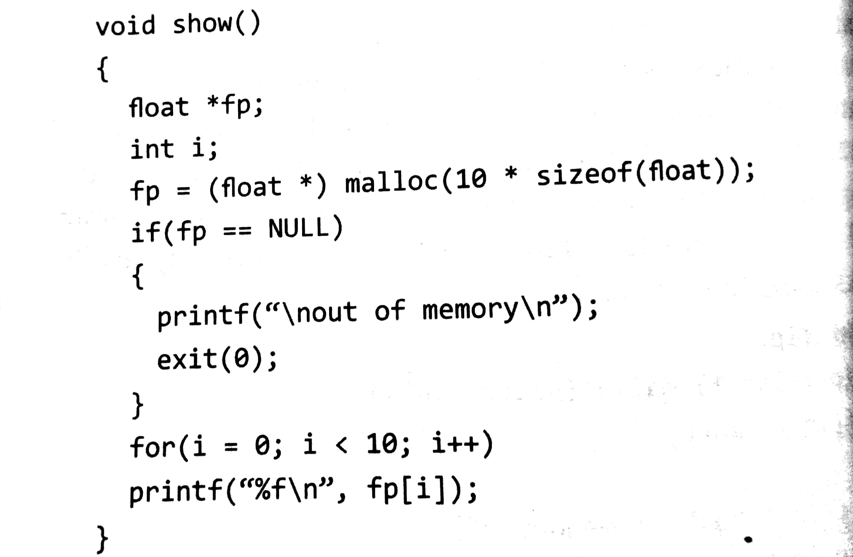
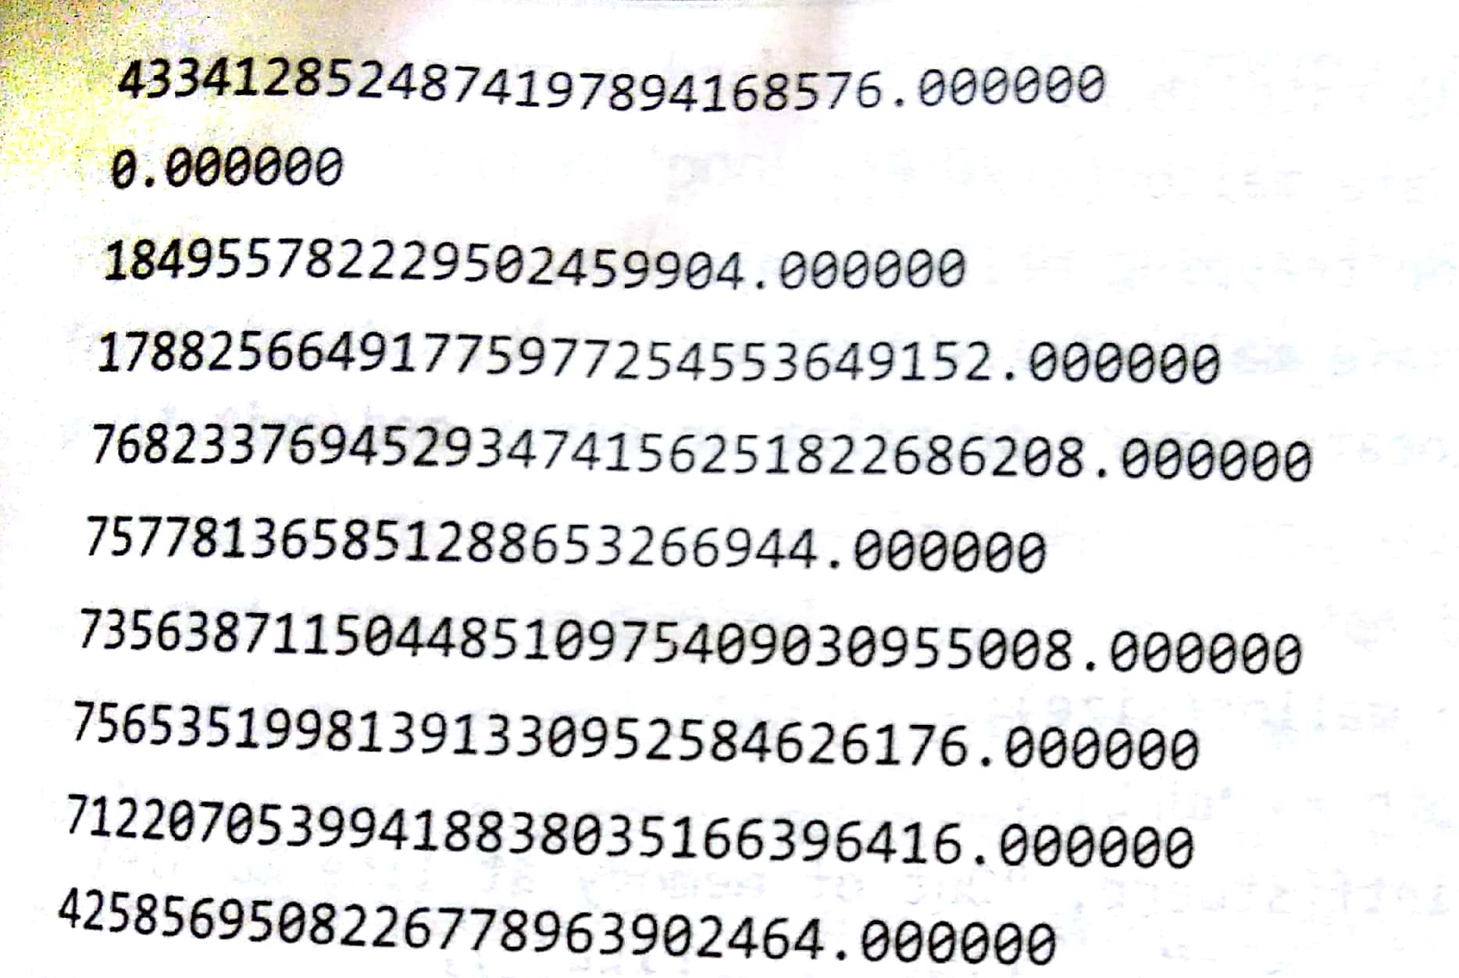
malloc() - Allocates memory but do not innitialize them

Slide 87
What was that result?
Program gives different result in different times depending on -
a) Who else is using computer
b) How much memory is used.
There may non zero values allocated (like int/char) but printf function tried to interpret as float. Hence better to initialize to make an useful array

Slide 88
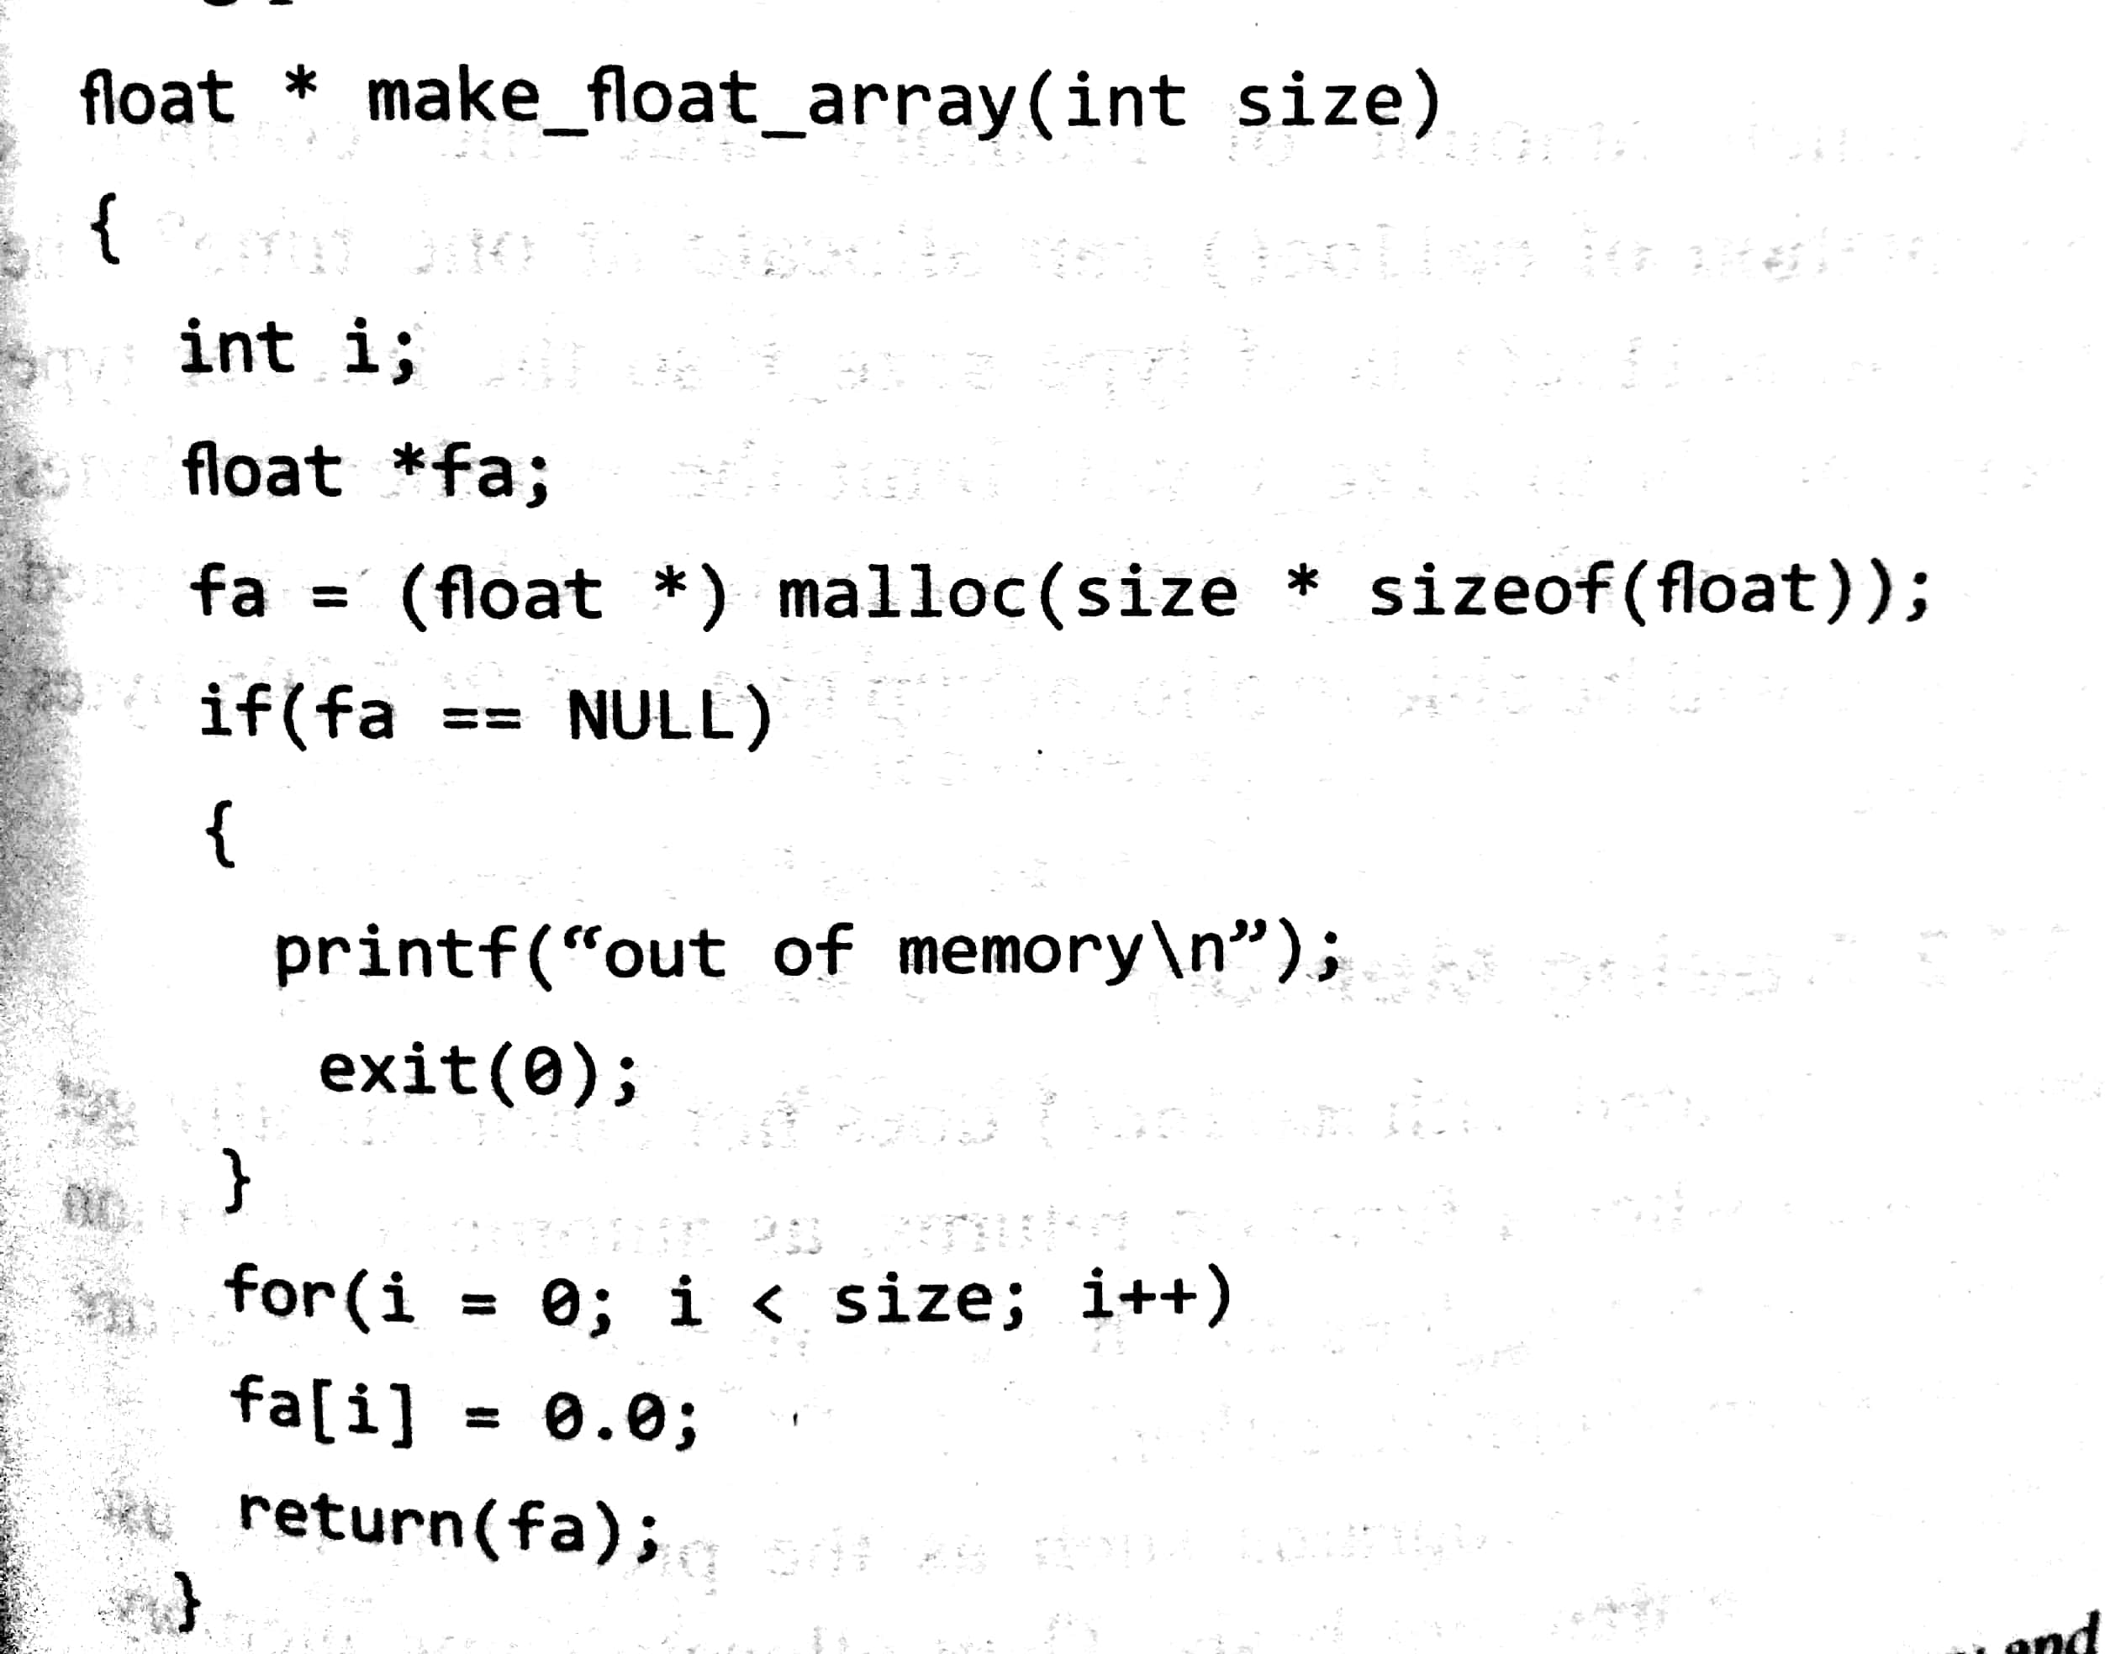
malloc() and initialize

Slide 89
calloc()
The name calloc stands for "contiguous allocation".
Syntax of calloc()
ptr = (cast-type*)calloc(n, element-size);
Example:
ptr = (float*) calloc(25, sizeof(float));
This statement allocates contiguous space in memory for an array of 25 elements each of size of float, i.e, 4 bytes.
Parameters
n − This is the number of elements to be allocated.
element-size − This is the size of elements.
Return Value
This function returns a pointer to the allocated memory, or NULL if the request fails.

Slide 90
#include <stdio.h>
#include <stdlib.h>
int main () {
int i, n;
int *a;
printf("Number of elements to be entered:");
scanf("%d",&n);
a = (int*)calloc(n, sizeof(int));
printf("Enter %d numbers:\n",n);
for( i=0 ; i < n ; i++ ) {
scanf("%d",&a[i]);
}
printf("The numbers entered are: ");
for( i=0 ; i < n ; i++ ) {
printf("%d ",a[i]);
}
free( a );
return(0);
}
Number of elements to be entered:3
Enter 3 numbers:
22
55
14
The numbers entered are: 22 55 14

Slide 91
memset()
Description
Copies the character c (an unsigned char) to the first n characters of the string pointed to, by the argument str.
Declaration
void *memset(void *str, int c, size_t n)
Parameters
str − This is a pointer to the block of memory to fill.
c − This is the value to be set. The value is passed as an int, but the function fills the block of memory using the unsigned char conversion of this value.
n − This is the number of bytes to be set to the value.
Return Value
pointer to the memory area str.

Slide 92
#include <stdio.h>
#include <string.h>
int main ()
{
char str[50];
strcpy(str,"This is string.h library function");
puts(str);
memset(str,'$',7);
puts(str);
return(0);
}
memset() function
This is string.h library function
$$$$$$$ string.h library function

Slide 93
Dynamic Memory Allocation
calloc() initializes all the bits in the allocated space set to zero where as malloc() does not do this.
A call to calloc() is equivalent to a call to malloc() followed by one to memset().
calloc(m, n) is essentially equivalent to
p = malloc(m * n); memset(p, 0, m * n);
When dynamically allocated, arrays are no longer needed, it is recommended to free them immediately.

Slide 94
Dynamic Memory Allocation
Freeing Memory : Dynamically allocated memory created with either calloc() or malloc() doesn't get freed on its own. You must explicitly use free() to release the space.
syntax of free()
free(ptr);
where ptr contains a pointer previously returned by malloc() or calloc()

Slide 95
realloc()
If the previously allocated memory is insufficient or more than required, you can change the previously allocated memory size using realloc().
Declaration
void *realloc(void *ptr, size_t size)
Parameters
ptr − This is the pointer to a memory block previously allocated with malloc, calloc or realloc to be reallocated. If this is NULL, a new block is allocated and a pointer to it is returned by the function.
size − This is the new size for the memory block, in bytes.
Return Value
This function returns a pointer to the newly allocated memory, or NULL if the request fails.

Slide 96
#include <stdio.h>
#include <stdlib.h>
int main ()
{
char *str;
/* Initial memory allocation */
str = (char *) malloc(15);
strcpy(str, "LearningC -");
printf("String = %s, Address = %u\n", str, str);
/* Reallocating memory */
str = (char *) realloc(str, 35);
strcat(str, "C is fun");
printf("String = %s, Address = %u\n", str, str);
free(str);
return(0);
}
String = LearningC-, Address = 355090448
String = C is fun, Address = 355090448

Slide 97
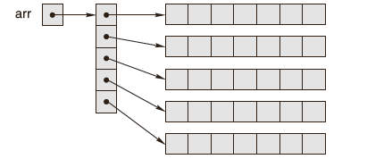
Dynamic Memory Allocation
Implementing Multidimensional Arrays using Pointers:
It is usually best to allocate an array of pointers, and then initialize each pointer to a dynamically allocated ‘row’.

Slide 98
Static and Dynamic memory allocation - difference
Dynamic meemory allocation refers to the memory allocation at runtime but static allocation declaration is done at compile time.
DMA memory comes from heap area and static alloation memory comes from stack area.DMA done using DMA function malloc,calloc.
Static allocation:
int arr[10];
Dynamic allocation
int *ptr;
ptr=(int *)malloc(sizeof(int)*10);

Slide 99
Calloc () and malloc() difference
malloc() | calloc()
The name malloc stands for memory allocation. | The name calloc stands for contiguous allocation
void *malloc(size_t n) returns a pointer to n bytes of uninitialized storage, or NULL if the request cannot be satisfied | void *calloc(size_t n, size_t size) returns a pointer to enough free space for an array of n objects of the specified size,or NULL if the request cannot be satisfied. The storage is initialized to zero.
malloc() takes one argument that is, number of bytes. | calloc() take two arguments those are: number of blocks and size of each block
syntax of malloc(): void *malloc(size_t n); | syntax of calloc(): void *calloc(size_t n, size_t size);
malloc is faster than calloc. | A call to calloc() is equivalent to a call to malloc() followed by one to memset().

Slide 100
Memory Leak & Memory Corruption
Dangling pointer
A pointer may be used to hold the address of dynamically allocated memory. After this memory is freed with the free() function (in C), the pointer itself will still contain the address of the released block. This is referred to as a dangling pointer.
Memory corruption
Memory when altered without an explicit assignment due to the inadvertent and unexpected altering of data held in memory or the altering of a pointer
to a specific place in memory is known as memory corruption.
Buffer overflow
Overwrite beyond allocated length char *a = malloc(128*sizeof(char));
memcpy(a, data, dataLen); /* Error if dataLen is too long. */

Slide 101
Pointer & Const Qualifier
Pointer to Constant
The const keyword can be used in the declaration of the pointer when a pointer is declared to indicate that the value pointed to must not be changed.
int n = 10;
const int *ptr=&n;
Constant Pointers
Constant pointers ensure that the address stored in a pointer cannot be changed. Consider the following statements -
int n = 10;
int *const ptr = &n; /* Defi nes a constant */

Slide 102
Pointer & Const Qualifier
Constant parameters
To prevent an array argument from being altered in a function, use the const qualifier as demonstrated in the next programs.
#include <stdio.h>
void change(char *);
int main(void)
{
char s[]=“Siva”;
change(s);
printf(“\n The string after calling change():\
%s”, s);
return 0;
}

